Slide 1


Retail Banking Transaction Analysis
MYSQL DATABASE PROJECT

Slide 2
Meet the Team
PROJECT TEAM
K. Baba Manikanta
P. V. S. Rithvik
K. Mahesh Babu
B.Tech
B.Tech
B.Tech
Why Data Science ?
Data Science combines technology, analysis, and real-world problem-solving, which interests me. It helps turn raw data into useful insights that can support better business decisions.
Why Data Science ?
What interests me about Data Science is the ability to turn data into meaningful insights. It combines technical and analytical skills to solve real business problems and support better decisions.
Why Data Science ?
Data Science connects technology with practical problem-solving. The opportunity to find patterns in data and use them to solve real-world problems is what makes this field interesting to me.
Fresher
Fresher
Fresher
https://www.linkedin.com/in/manikanta-datascience
babamanikanta (KURMALA CHENCHU BABA MANIKANTA) · GitHub
RETAIL BANKING ANALYTICS

Slide 3

01 · INTRODUCTION
Project Overview
Retail Bank serves customers through accounts, cards, and loans across a multi-branch network. As a Data Analyst supporting the Retail Banking team, this project moves from raw transactional data to data-driven business insight — understanding customers, account activity, transaction patterns, and loan performance.
500
700
Customers
Accounts
1
Understand the business & data model
5,000
$35.9M
2
Build the MySQL database from the ER diagram
Transactions
Total Transaction Value
3
Explore & analyze data with SQL
4
Translate results into business insight
RETAIL BANKING ANALYTICS
4

Slide 4
02 · CONTEXT
Business Scenario
Retail banking touches nearly every part of a customer's financial life — deposits, cards, and loans — and each product generates its own stream of activity: transactions to process, balances to manage, and repayments to track.
Branch Network
Rising Activity
Mixed Outcomes
A network of 40 branches across 5 regions serves 500 customers through 700 accounts, 600 cards, and 300 loans.
Transaction volume grew over 50% from 2022 (1,279) to 2024 (1,933), adding load on processing and support.
Only 33.76% of transactions complete successfully — Failed (32.56%) and Pending (33.68%) are nearly as common.
RETAIL BANKING ANALYTICS

Slide 5
03 · CONTEXT
Business Objectives
Customer Management — Maintain customer profiles, demographics, income and credit information.
Account Management
Track account types, balances, status and branch relationships.
Transaction Analysis
Record transaction type, amount, channel and transaction status.
Loan Management
Monitor loans, outstanding balances, interest rates and repayment behaviour.
Card Management
Maintain debit and credit card information linked to customer accounts.
Analytical Reporting
Generate reports for customer behaviour, product usage and banking performance.
RETAIL BANKING ANALYTICS

Slide 6
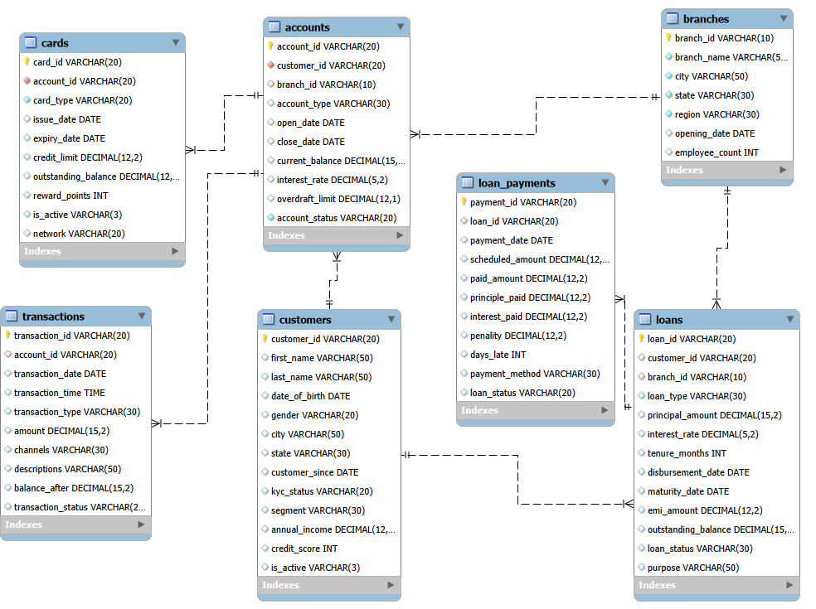
ENTITY-RELATIONSHIP DIAGRAM:-
RETAIL BANKING ANALYTICS

Slide 7
DATABASE SCHEMA OVERVIEW:-
Customers:- Stores personal details, location, customer segment, income and credit score.
Accounts:- Stores account type, branch, opening details, balance and account status.
Branches:- Contains branch name, city, state, region and manager information.
Transactions:- Records banking transactions including amount, type, channel and status.
Loans:- Stores loan details, interest rates, outstanding balances and loan status.
Loan Payments:- Tracks payment amount, penalties, days late and repayment status.
Cards:- Stores debit/credit card details, network, limits and active status.
RETAIL BANKING ANALYTICS

Slide 8
SQL QUERIES: BANKING INSIGHTS:-
1.What are the different customer segments, and how many customers belong to each segment?
SELECT
Segment,
COUNT(*) AS Customer_Count
FROM customers
GROUP BY Segment;
Segment | Customer_count
Business | 97
Premium | 76
Retail | 80
Senior | 73
Student | 100
Wealth | 74
Output
RETAIL BANKING ANALYTICS

Slide 9
SQL QUERIES: BANKING INSIGHTS:-
2. How many accounts exist for each account type and what is the total balance?
account_type | Accounts | Total_Balance
IRA | 136 | 2,894,008
Certificate of Deposit | 118 | 2,602,682
Business Checking | 116 | 2,062,364
Money Market | 110 | 1,654,751
Savings | 117 | 576,190
Checking | 103 | 408,284
SELECT
account_type,
COUNT(*) AS accounts,
SUM(current_balance) AS total_balance
FROM accounts
GROUP BY account_type
ORDER BY total_balance DESC;
3. Retrieve customers who do not have any active account.
customer_id | first_name | last_name
C000003 | Xiao | Green
C000005 | Vijay | Jung
C000007 | Jason | Koné
C000008 | Cynthia | Wu
C000011 | Laura | Kim
C000012 | Alexander | Smith
C000013 | Sandra | Kim
C000014 | Sharon | Gonzalez
SELECT
c.customer_id,
c.first_name,
c.last_name
FROM customers c
LEFT JOIN accounts a
ON c.customer_id=a.customer_id AND a.status='Active'
WHERE a.account_id IS NULL;
RETAIL BANKING ANALYTICS

Slide 10
SQL QUERIES: BANKING INSIGHTS:-
4. For each transaction channel, retrieve transaction count and total transaction amount.
channel | Transactions | Total_Amount
Online | 1470 | 10,948,892
Branch | 1144 | 7,989,209
Mobile | 1024 | 7,476,419
ATM | 857 | 5,939,130
POS | 281 | 1,963,521
Wire Transfer | 224 | 1,574,036
SELECT channel, COUNT(*) AS transactions,
SUM(amount) AS total_amount
FROM transactions
GROUP BY channel
ORDER BY transactions DESC;
5. For each branch, retrieve the number of loans and total outstanding balance.
branch_name | Loans | Outstanding
Jacksonville Branch | 29 | 6,550,194
Washington Branch | 28 | 3,797,633
Atlanta Branch | 25 | 4,278,692
Memphis Branch | 19 | 3,071,759
San Diego Branch | 15 | 2,580,257
Boston Branch | 15 | 2,542,675
Austin Branch | 14 | 2,893,215
Los Angeles Branch | 14 | 3,217,550
SELECT b.branch_name, COUNT(l.loan_id) AS loans,
SUM(l.outstanding_balance) AS outstanding
FROM branches b JOIN loans l
ON b.branch_id=l.branch_id
GROUP BY b.branch_name
ORDER BY loans DESC;
RETAIL BANKING ANALYTICS

Slide 11
SQL QUERIES: BANKING INSIGHTS:-
6. Retrieve customers who have more than one bank account.
first_name | last_name | account_count
Anna | Jones | 8
Pooja | Garcia | 6
Janet | Jones | 5
Brenda | Hall | 5
Liam | Choi | 5
Dorothy | Flores | 5
Lei | Green | 4
Christopher | Iyer | 4
SELECT
customer_id, COUNT(*) AS account_count
FROM accounts
GROUP BY customer_id
HAVING COUNT(*) > 1
ORDER BY account_count DESC;
7. For each loan type, retrieve the number of loans and total outstanding balance.
loan_type | Loans | Outstanding
Education | 64 | 10,937,738
Business | 52 | 10,056,248
Home | 42 | 8,364,122
Credit Builder | 49 | 8,300,285
Auto | 48 | 8,107,013
Personal | 45 | 7,676,486
SELECT loan_type, COUNT(*) AS loans,
SUM(outstanding_balance) AS outstanding
FROM loans
GROUP BY loan_type
ORDER BY outstanding DESC;
RETAIL BANKING ANALYTICS

Slide 12
KEY INSIGHTS:-
Customer segments provide a foundation for targeted banking products and personalized offers.
Account balances differ significantly by account type, helping identify high-value products.
Transaction analysis reveals how customers use banking channels and services.
Branch-level loan reporting supports portfolio monitoring and regional comparisons.
Multi-account customers indicate cross-selling and deeper product engagement opportunities.
Loan outstanding analysis helps management focus on larger credit exposures.
RETAIL BANKING ANALYTICS

Slide 13
KEY INSIGHTS:-
BANKING PERFORMANCE INSIGHTS
Online is the most frequently used transaction channel in the dataset.
IRA accounts contribute the highest total account balance.
Education loans carry the largest outstanding balance.
Customers with multiple accounts represent a strong opportunity for relationship banking.
Loan repayment records can be used to identify late and missed payment patterns.
RETAIL BANKING ANALYTICS

Slide 14
CHALLENGES FACED:-
Designing Relationships
Establishing relationships among seven tables using primary and foreign keys.
Data Consistency
Maintaining referential integrity across connected banking tables.
Complex SQL Queries
Writing multi-table JOIN and aggregate queries for analytical reporting.
Financial Analysis
Handling balances, transaction amounts, outstanding loans and repayments.
Query Optimization
Organizing queries efficiently for grouped and customer-level analysis.
Testing
Using realistic datasets to validate SQL outputs and insights.
RETAIL BANKING ANALYTICS

Slide 15
CONCLUSION:-
The Retail Banking Transaction Analysis project provides a structured database solution for managing and analysing customer, account, transaction, loan and card data.
Key achievements include:
Well-structured relational database design.
Proper implementation of primary and foreign keys.
Successful execution of analytical SQL queries.
Improved visibility into customer behaviour and banking products.
Insights into transactions, balances, loans and product engagement.
Scalable architecture that can support future dashboards and advanced analytics.
RETAIL BANKING ANALYTICS

Slide 16

THANK
YOU
RETAIL BANKING ANALYTICS

